Slide 1
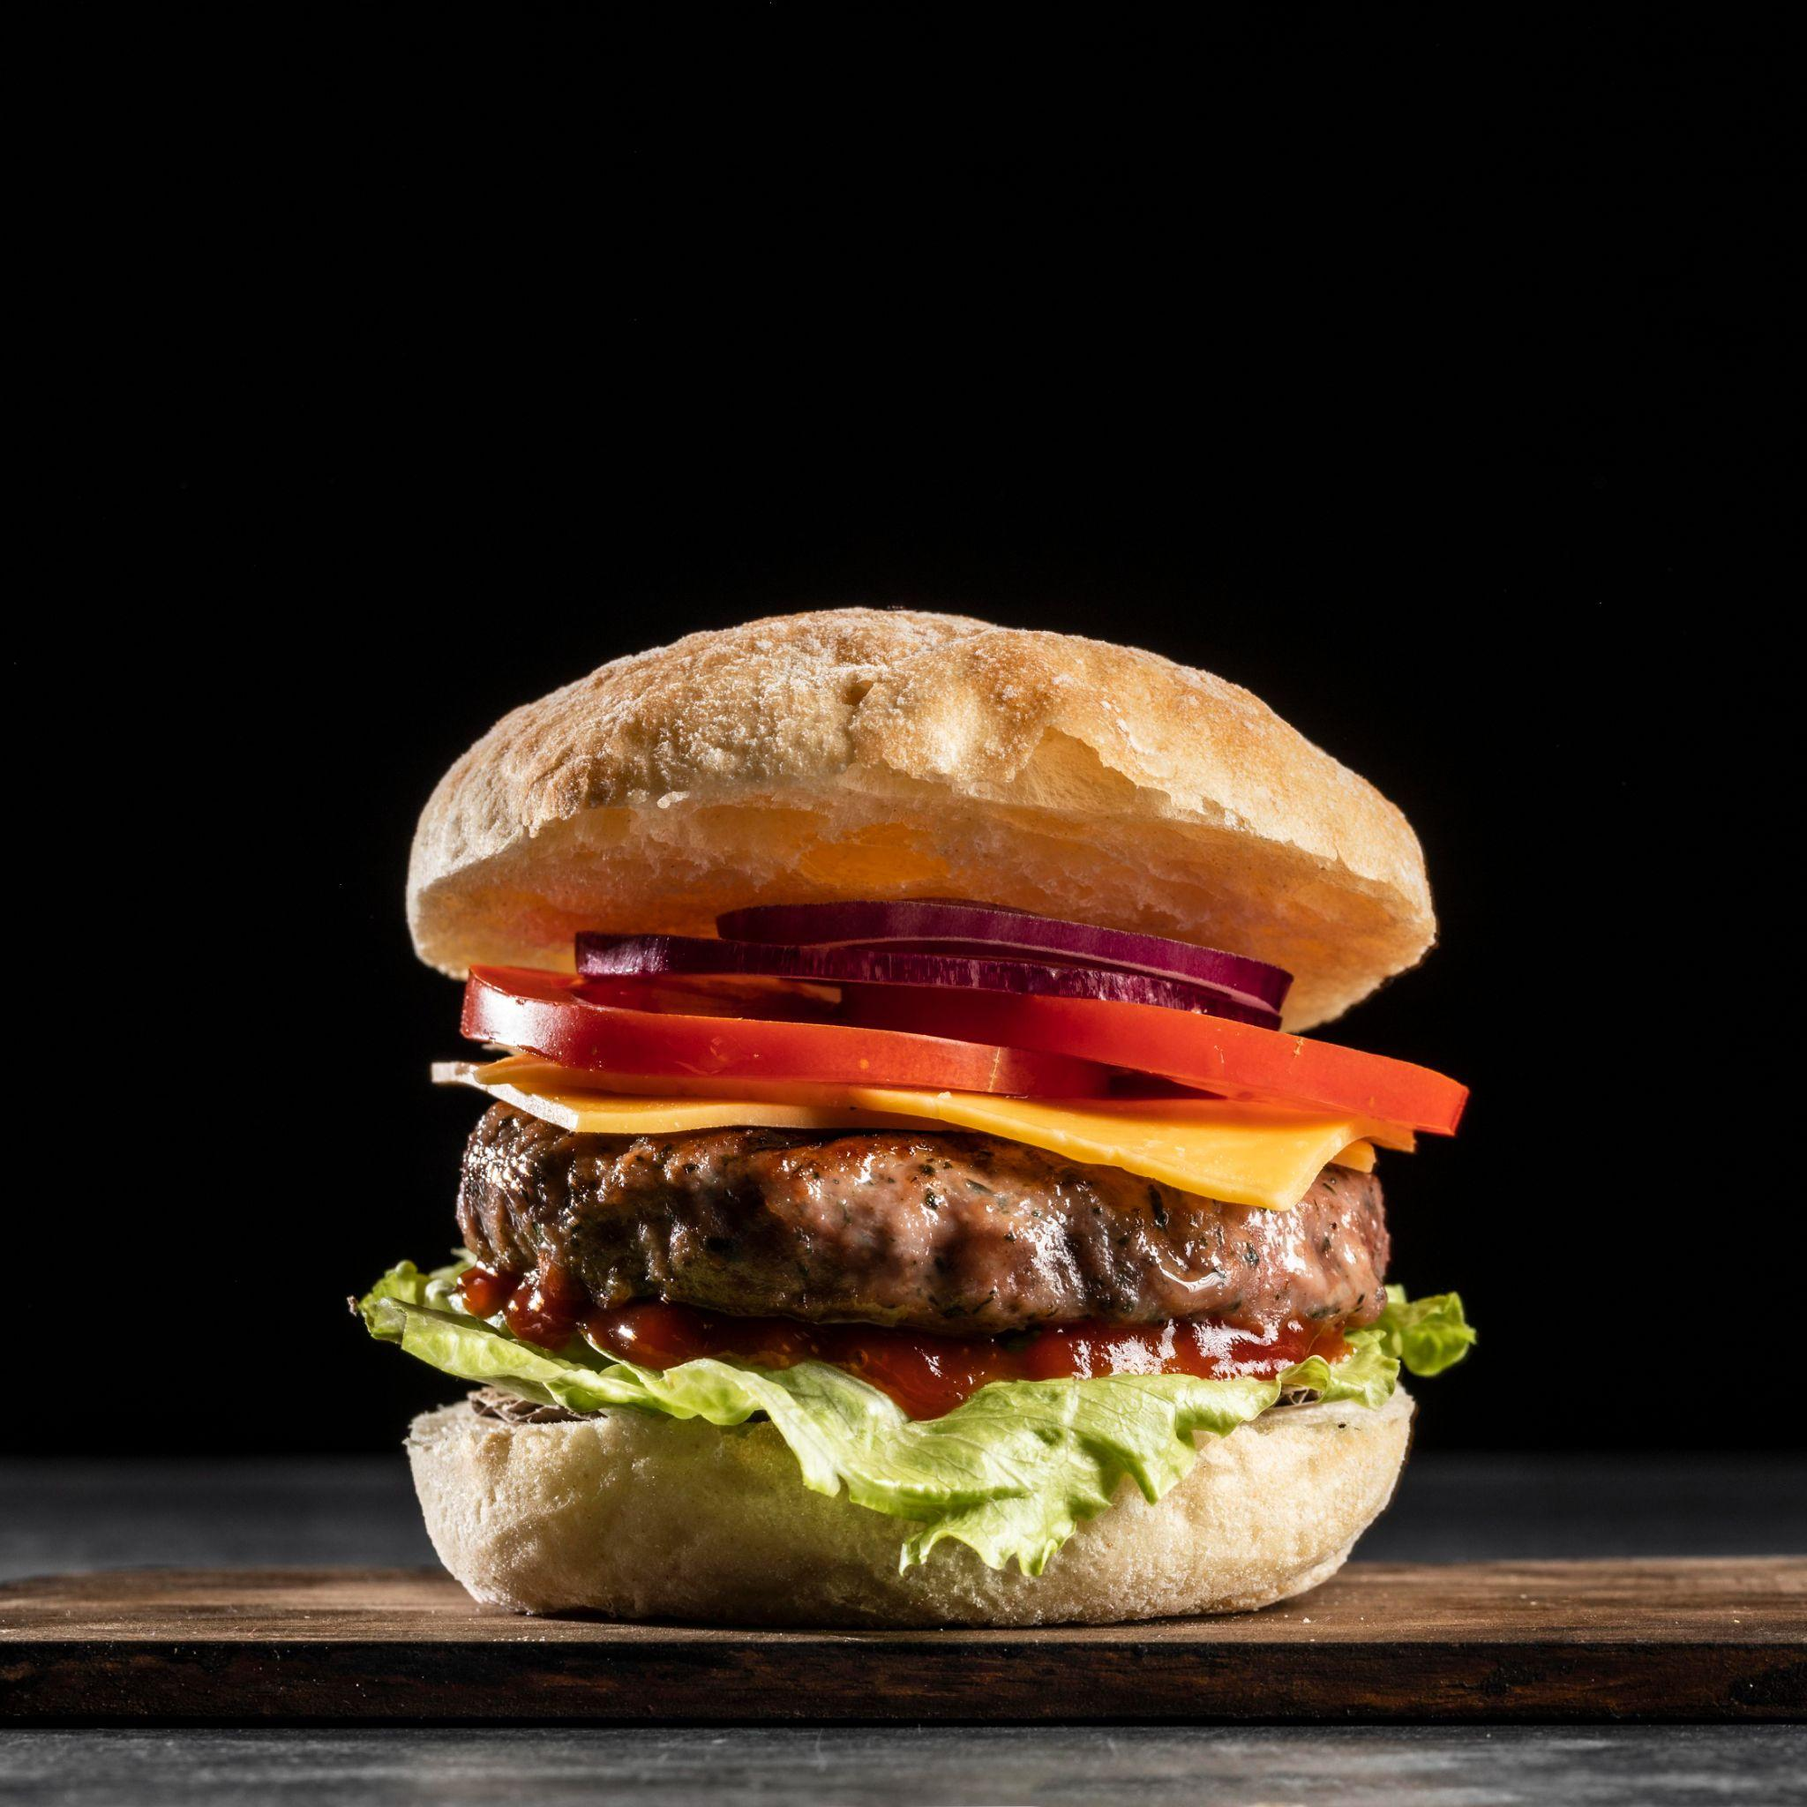
Food Ordering & Delivery Platform

Slide 2
Table of contents
01
02
03
04
05
Introduction
Key Features
Technical Implementation
06
User Journey
Future Enhancements
Marketing and growth
strategies

Slide 3
Introduction
Objective:
Create a user-friendly and efficient food ordering and delivery website.
Problem statement:
Inefficiencies and complexities in current food delivery platforms
Market research:
Growing demand for online food ordering and delivery services

Slide 4

Key Features
User-friendly interface for easy navigation
Extensive restaurant selection with various cuisines
Customizable menu options and dietary preferences
Secure payment gateways for hassle-free transactions

Slide 5
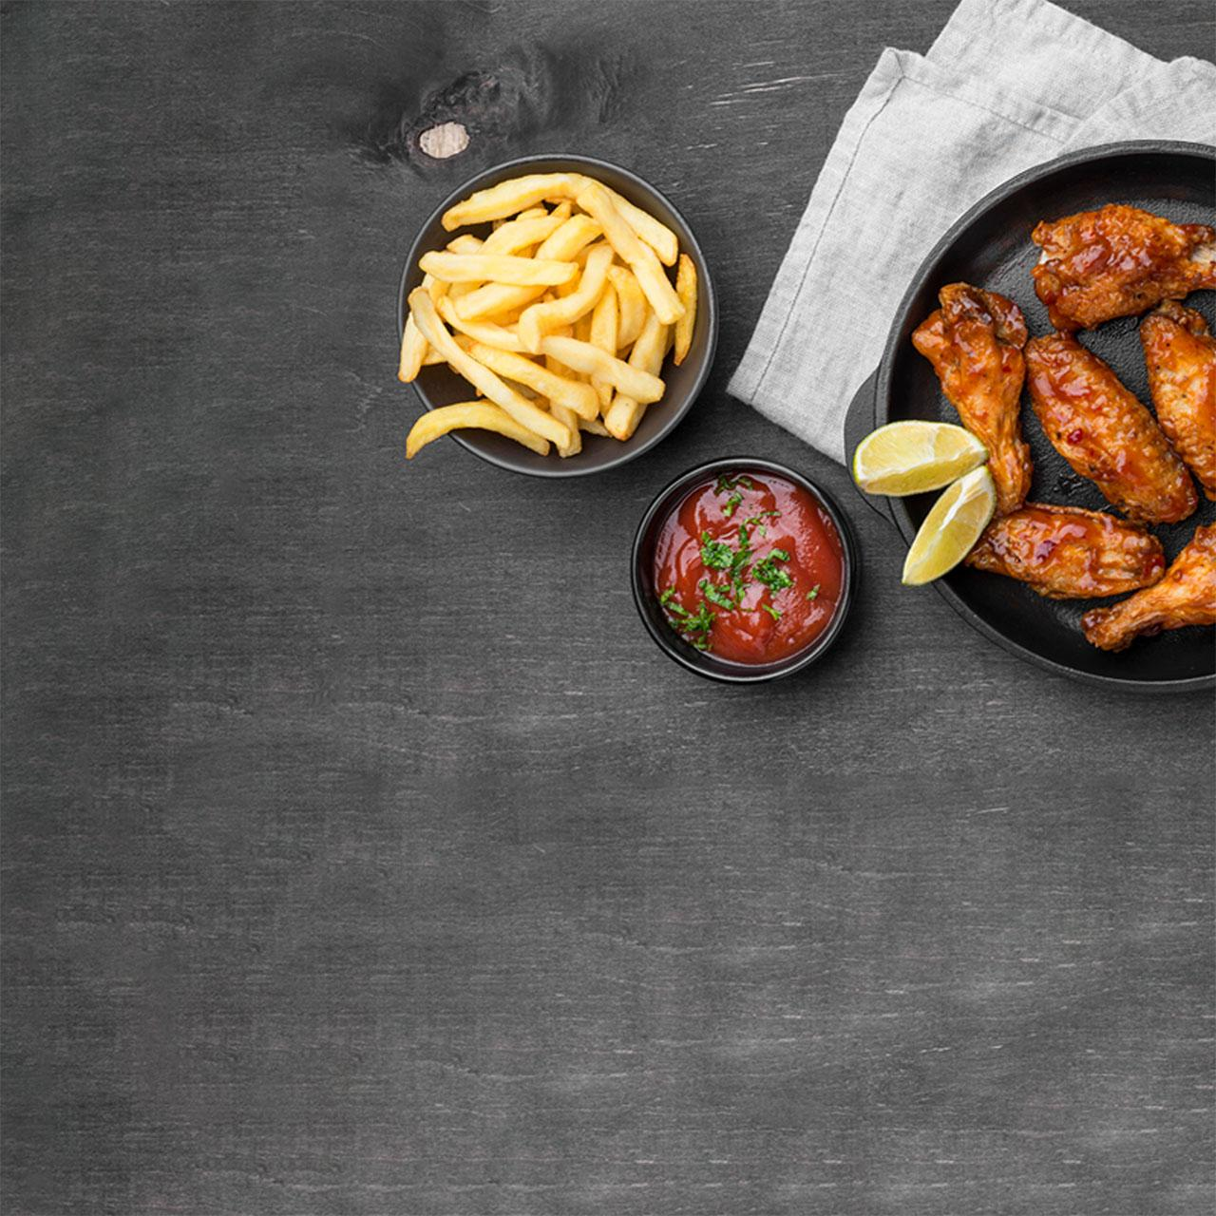
Technical implementation
Front-end: Responsive web design using HTML, CSS, and JavaScript, and React
Back-end: Utilizing a robust and scalable database from firebase
Integration with payment gateways and external APIs for menu and restaurant data

Slide 6
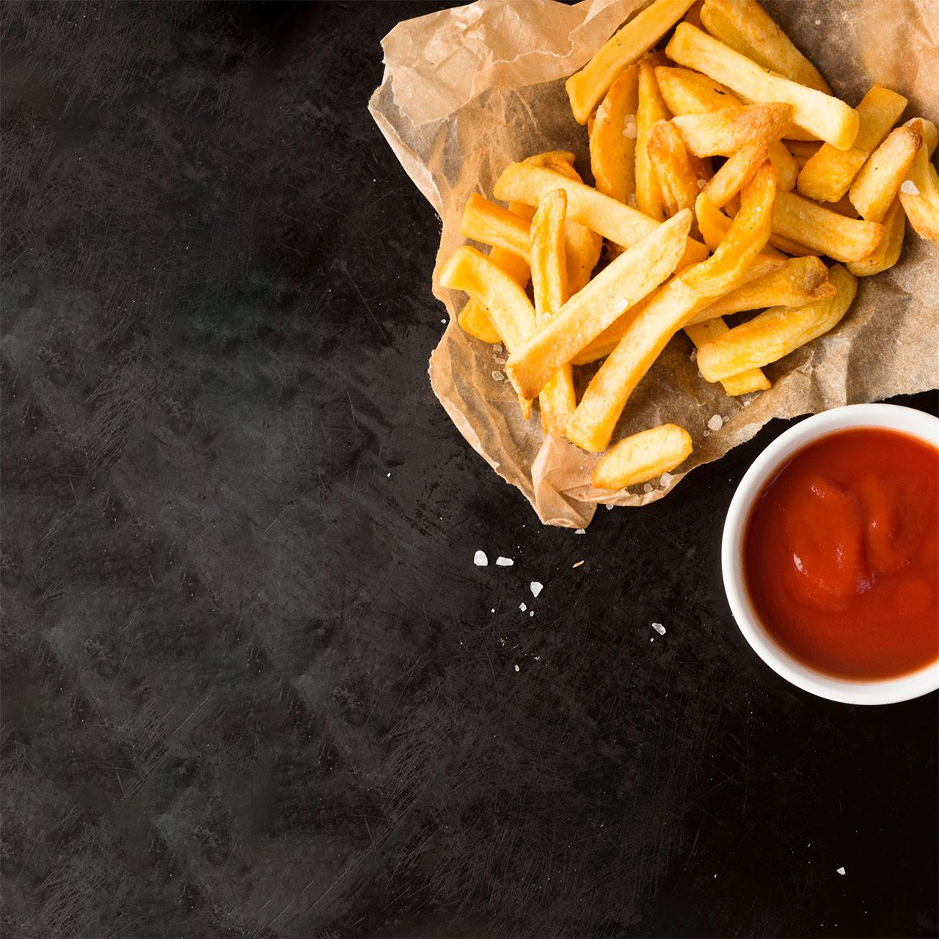
User Journey
Registration and login process
Browsing and searching for restaurants and dishes
Adding items to the cart and customizing orders
Placing orders and selecting delivery options

Slide 7
Marketing & growth Strategies
Collaborating with popular restaurants for exclusive offers
Implementing referral programs and discounts for user acquisition
Social media campaigns and targeted advertisements

Slide 8
Future Enhancements:
Mobile app development for iOS and Android platforms
AI-driven recommendation system for personalized suggestions
Integration with third-party delivery services for wider reach
Real-time order tracking and delivery updates

Slide 9
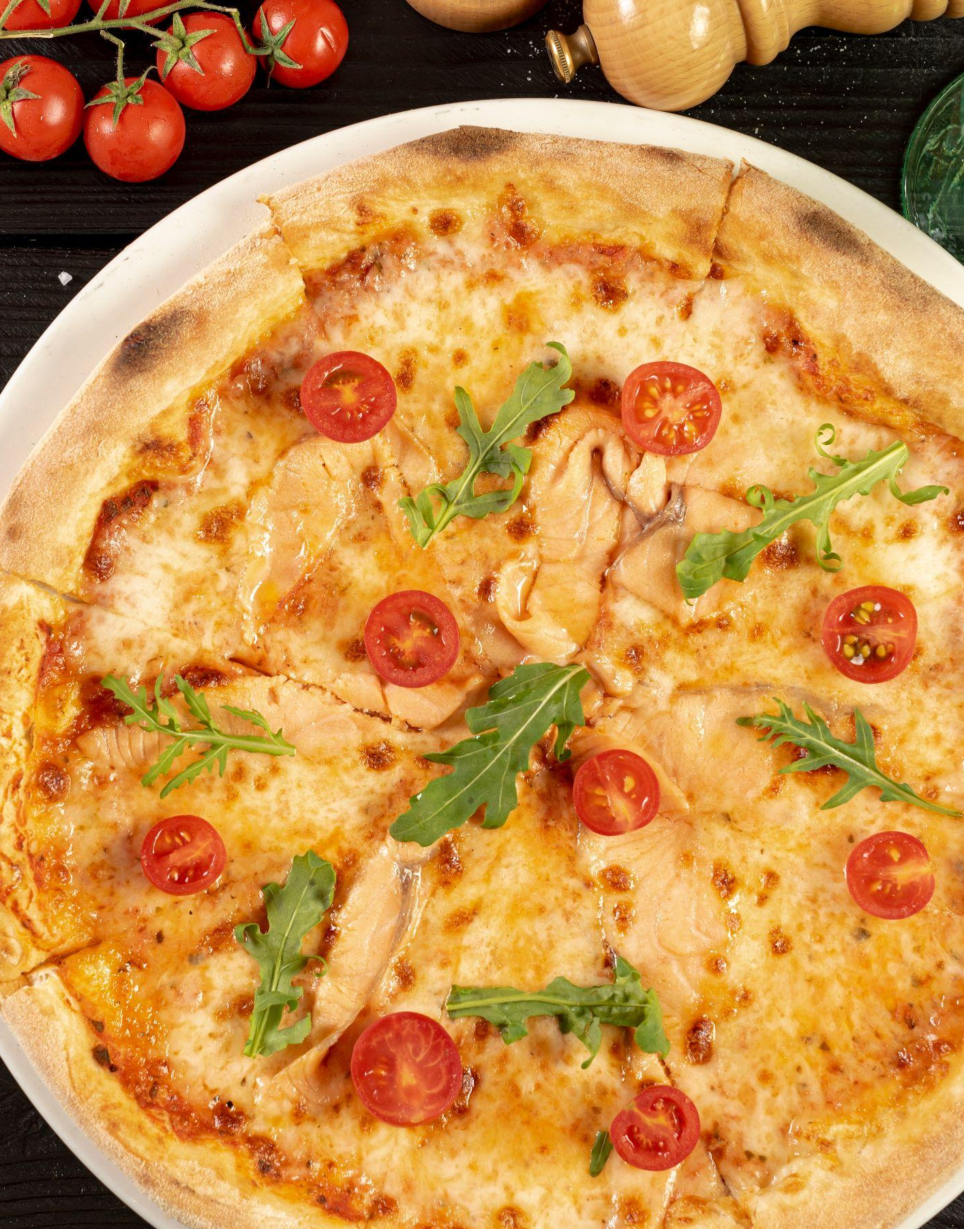
Thanks!
Prepared By:
- Abdelrahim Mohamed - Sara Abdelraheem
- Ahmed Adel Abo Elwafa - Manar Montaser
- Ahmed Shams - Jena Hana

